Slide 1
Building a knowledge platform for agriculture and rural development: Evidence-based learning and results based management in Myanmar.
Livelihoods and Food Security Trust Annual Forum
Nay Pyi Taw
25-26th November 2014
Dr Yvonne Pinto
yvonne@yvonnepinto.com

Slide 2
Overview
A knowledge platform?
Knowledge Management and M&E
Learning about what: defining the learning agenda
Results framework, TOC and M&E
Evaluations and research studies
A digital knowledge platform
Enabling evidence-based learning
2

Slide 3
Knowledge Management and M&E
Monitoring and Evaluation
Measurement and interpretation of the outputs, outcomes and impacts of an intervention
Focus on the data itself
Emerges from an accountability paradigm
Knowledge management
Knowledge as a resource focusing on how it is produced, shared and applied (or lost, misused) in diverse organisational or institutional settings
About people, their relationships and what they can do with data
Emerges from a learning and performance paradigm
M&E and KM are different yet complementary. M&E can be the foundation for structured primary evidence about the extent to which an intervention is achieving what it set out to achieve.
KM can help to ensure that the data gets translated into learning – i.e. new understanding and new ways of working – in service of strategic goals.

Slide 4
A knowledge platform?
Internal:
Ensure that implementing partners, and key internal stakeholders are engaged in a robust, evidence-based learning process.
Ensuring a robust and systematic M&E framework is in place to build the evidence base in relation to the learning agenda;
Building the capacity, skills and knowledge of implementation partners in a manner that helps them learn from each other and improve their performance in line with LIFT objectives.
Government will occupy a position that straddles inside and outside as it increasingly becomes an active partner in both the implementation and learning processes.
External:
Engaging the broader network of development partners, particularly the government but also donors and other implementing organisations outside of LIFT in the learning process;
Formulating sectoral learning agendas, participating in various learning activities:
Sectoral working group meetings and COPs
Periodic progress review meetings, meetings at the Fund and board levels and with strategic steering/management/technical committees.
Emphasis on ensuring that external actors will be part of the learning process and will have ownership of the evidence generated.

Slide 5
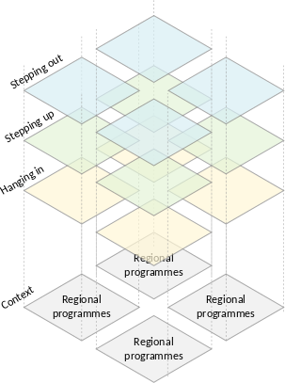
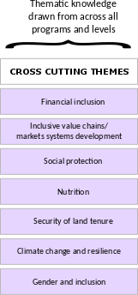
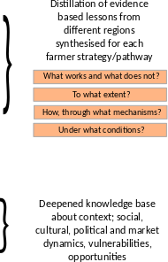
Learning about what? Defining a learning agenda
Whose learning? Who defines the agenda?

Slide 6
Results Framework, TOC and M&E
A Theory of Change articulates how those involved in a change process understand how change takes place. In particular it:
Articulates a common vision of change for a specific system
Defines the actors and explores their role in contributing to specific changes
Traces the casual pathways that connect activities, to outputs and various levels of outcomes (including unintended outcomes)
Identifies the internal and external factors that can (enable, constrain) shape the change process
Clarifies the assumptions that must hold in order for the change process to hold together
A results framework spells out the activities, outputs, outcomes and goal/vision of a programme/intervention.
A results framework is more of a performance measurement tool than a learning tool.

Slide 7
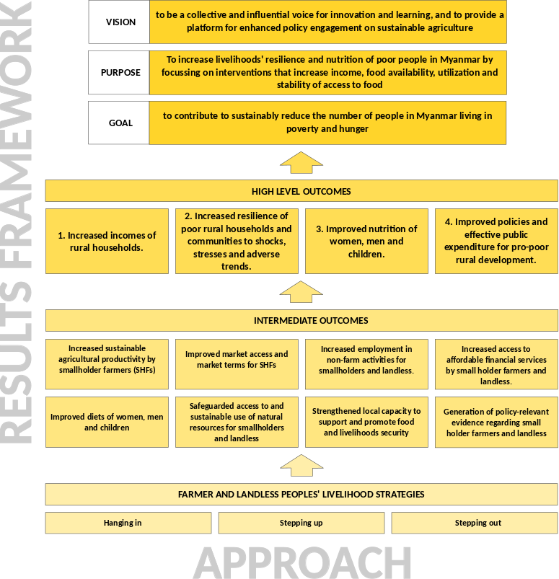
Results Framework, TOC and M&E
The LIFT Results Framework defines specific outputs and outcomes (i.e. changes) that LIFT seeks to contribute to.
It serves as:
An accountability tool for establishing reporting commitments (upward to donors and from IPs below)
A planning tool for framing programme level strategies
A tool for organizing evidence to support Knowledge management

Slide 8
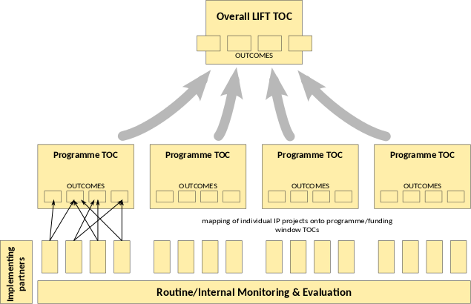
Results Framework, TOC and M&E
LIFT TOC & Results Framework defines higher-level outcomes/outputs for programme level outcomes/outputs.
Individual Implementing Partners contribute to specific programme level outputs/outcomes through their activities.
IPs carry out routine M&E in a systematic manner on the basis of programme TOCs and their own interventions.
External/commissioned evaluations of programmes and research studies on key themes to validate internal M&E and answer specific evaluation and learning questions
Robust internal M&E by IPs provides evidence about what works, what does not, to what extent, under what conditions. Helps to answer programme and relevant sectoral learning questions.

Slide 9
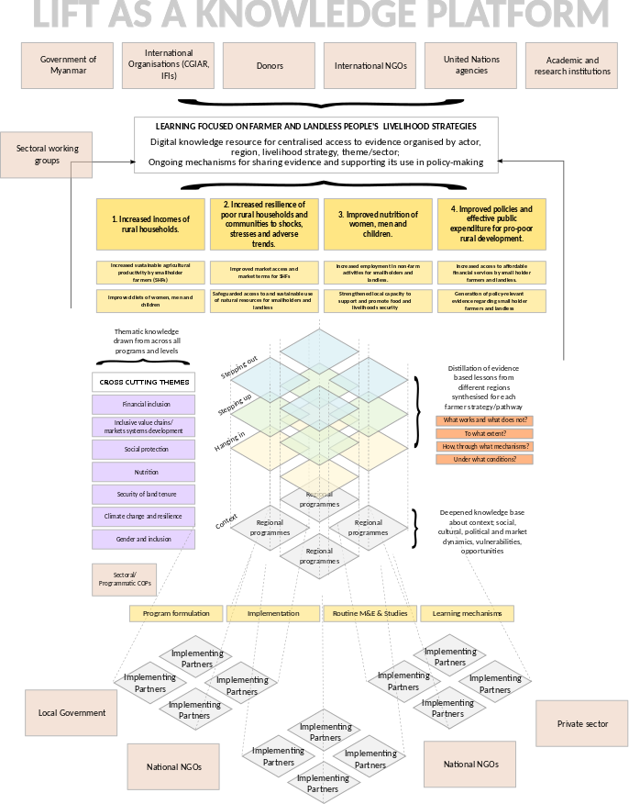
Knowledge portal
An online repository of evidence organised by:
Outcomes/Thematic area
Livelihood strategies/pathways
Geographic region
Types of use/user
Content:
Progress against outcomes
Case studies of specific interventions
Syntheses of lessons learned by IPs through internal M&E (programme/sector-specific)
Syntheses of insights in relation to learning agendas through thematic workshops
Robust external evaluations on LIFT/programme performance to identify scaleable solutions, opportunities for improvement and risks, challenges to be addressed
Selected research studies to deepen understanding of key issues

Slide 10
Enabling Evidence Based Learning
Common formulation of TOCs to create a common vision and define outcomes and programme-specific learning agendas
Defining learning agendas
Myanmar-level
Livelihood strategies
Programme level
Sectoral/thematic
Conducting robust internal and external M&E within a shared, structured framework
Creating and maintaining an online knowledge portal
Creating learning mechanisms and events
Opportunities for wider network of knowledge users to participate in governance and shape learning agendas
Communities of practice
Programme and sectoral synthesis workshops and reports
Capacity development

